Slide 1


www.drupaleurope.org

Slide 2

Human side of technological transition
Peter Keppert
Community

Slide 3
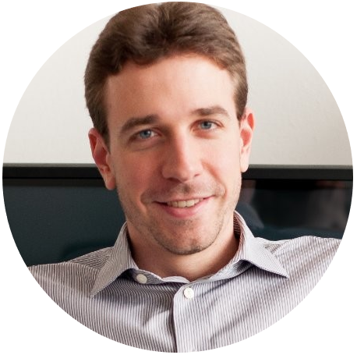
Peter Keppert
Head of Web Development
Ferratum

Slide 4
Agenda
Introduction
Failure as driver of progress
Problems and solutions
Final thoughts

Slide 5
Introduction

Slide 6
Introduction
What to expect
Story of one company, one team and one project
Account of personal experience and our approach to solving issues, not a scientific study
Goal: thinking, inspiration
Not a how-to guide, what worked for our team might not work elsewhere

Slide 7
Introduction
Technological background
Project: Migration of Drupal 7-based frontends to a decoupled solution
New tech stack: Angular, Drupal 8, NodeJS, GraphQL
Focus: management challenges arising from a fundamental technological transformation
Lot of in-house experience with Drupal, no exposure to Angular and NodeJS. Engineers building PoC were later integrated into the team.

Slide 8
Failure as driver of progress

Slide 9
Failure as driver of progress
Symptoms of my struggle: demotivation and loss of enjoyment of work
Response to obstacle depends on personality, how much you are ready to change
Failure: unprepared for project’s transition form PoC phase
How to handle failure: adopt blameless attitude
How to stay focus on the big picture: make time to step out of daily routine

Slide 10
Failure as driver of progress
Failures expedite changes, they are drivers of progress.

Slide 11
Failure as driver of progress
Specific problems:
Chaotic management of priorities
Team size and composition
Tense atmosphere

Slide 12
Problems and solutions

Slide 13
Problems and solutions
Chaotic management of priorities
            Problem: Different views of priorities, focus on short-term goals, no longer-term planning
            Our approach: Standardization of development workflow, focus on documentation and prioritization
            Result: smoothly working distributed team
            How to keep your sanity: time management

Slide 14
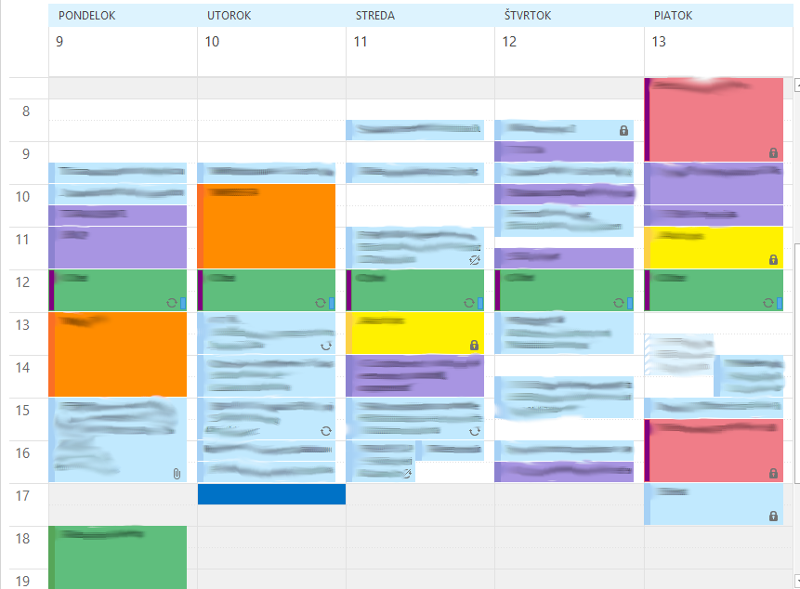
Problems and solutions
Chaotic management of priorities

Slide 15
Problems and solutions
Team size and composition
            Problem: Challenging job market
            3 strategies:
            Expanding developers’ skills (midterm)
            Utilizing external suppliers (short term)
            Expanding team with junior members (long term)
            Key to success: start with what you already have, think of the present and the future

Slide 16
Problems and solutions
Team size and composition / Expanding developers’ skills
            Problem: We had a pool of seasoned Drupal developers and at the same time needing more Angular capacities
            Our approach: investment in the education of internal developers
            Result: notable enhancement of the team and career development path for legacy developers
            Key to success: adaptive mindset

Slide 17
Problems and solutions
Team size and composition / Utilizing external suppliers
            Problem: We had a solution to capacity issues for midterm, but not short term
            Our approach: Integrate teams as much as possible, let externals participate in analysis and design phase
            Result: capacity increase, expertise we can build on internally
            Key to success: diversify to spread the risks

Slide 18
Problems and solutions
Team size and composition / Internal diversification
            Problem: As project matures, there are usually more simpler than complex tasks
            Our approach: expanding the team with junior developers
            Result: Motivated juniors bring new energy to established team, opportunity to mentor for seniors and capacity increase in the long run
            Key to success: trust your team and give people opportunities for self-realization

Slide 19
Final thoughts

Slide 20
Final thoughts
Takeaways
            Learn from your own and others’ failures
            Focus on the big picture, present and future
            Choose smart solutions, get the most out of them
            Diversify whenever you can
            Trust the people, build your success on people

Slide 21
Become a Drupal contributor Friday from 9am
First timers workshop
Mentored contribution
General contribution

Slide 22
Thanks!
Questions? Answers.

